Slide 1
Intel® Curie™
Arduino 101
Louis Milia
louismil@buffalo.edu
https://www.linkedin.com/in/louis-milia/
https://github.com/AilimiSoul

Slide 2
A Brief History
Arduino project started in 2003 named after a bar in Ivrea, Italy where some of the founders of the project would meet

Slide 3
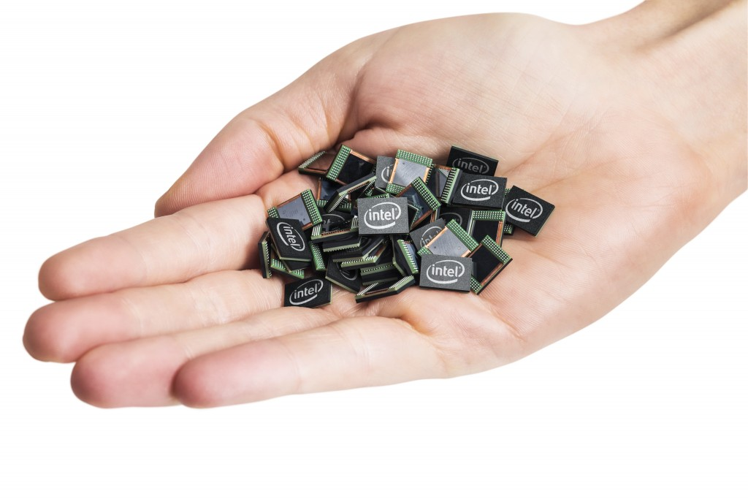
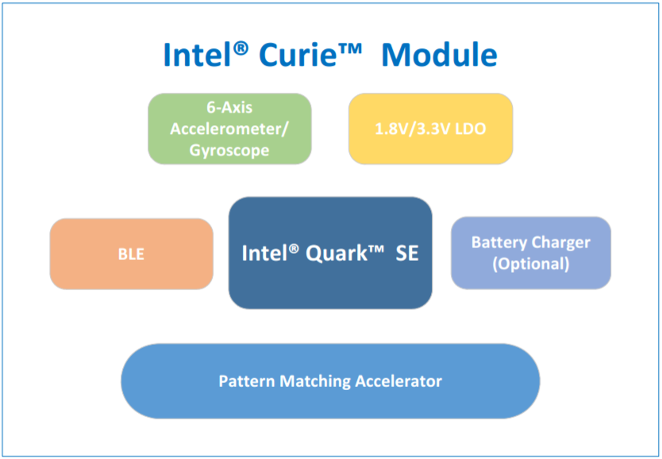
Intel Curie Module

Slide 4
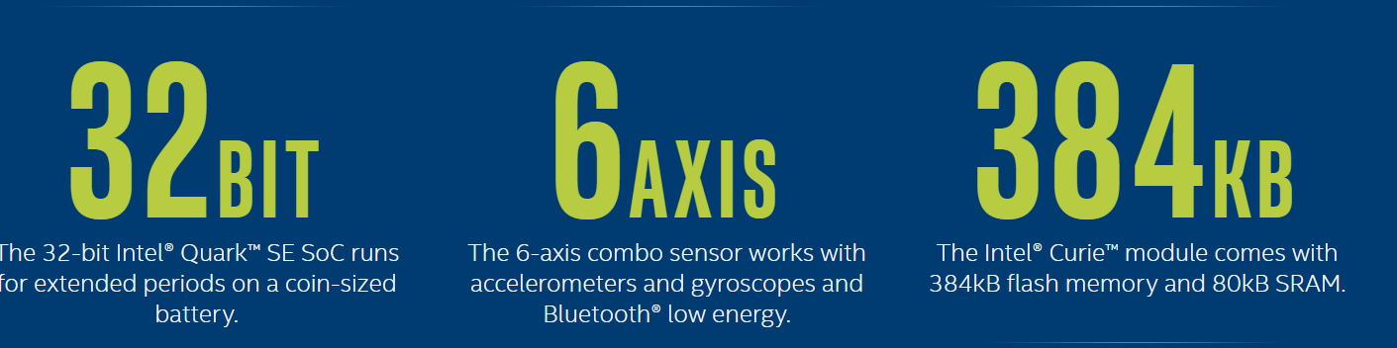
Curie Module Specifications
Intel Quark SE Microcontroller C1000 Processor core (32 MHz, 32 bit architecture)
384 kB flash memory, 80 kB SRAM
1.8V or 3.3V Power req.
-25 to 70°C operating range

Slide 5
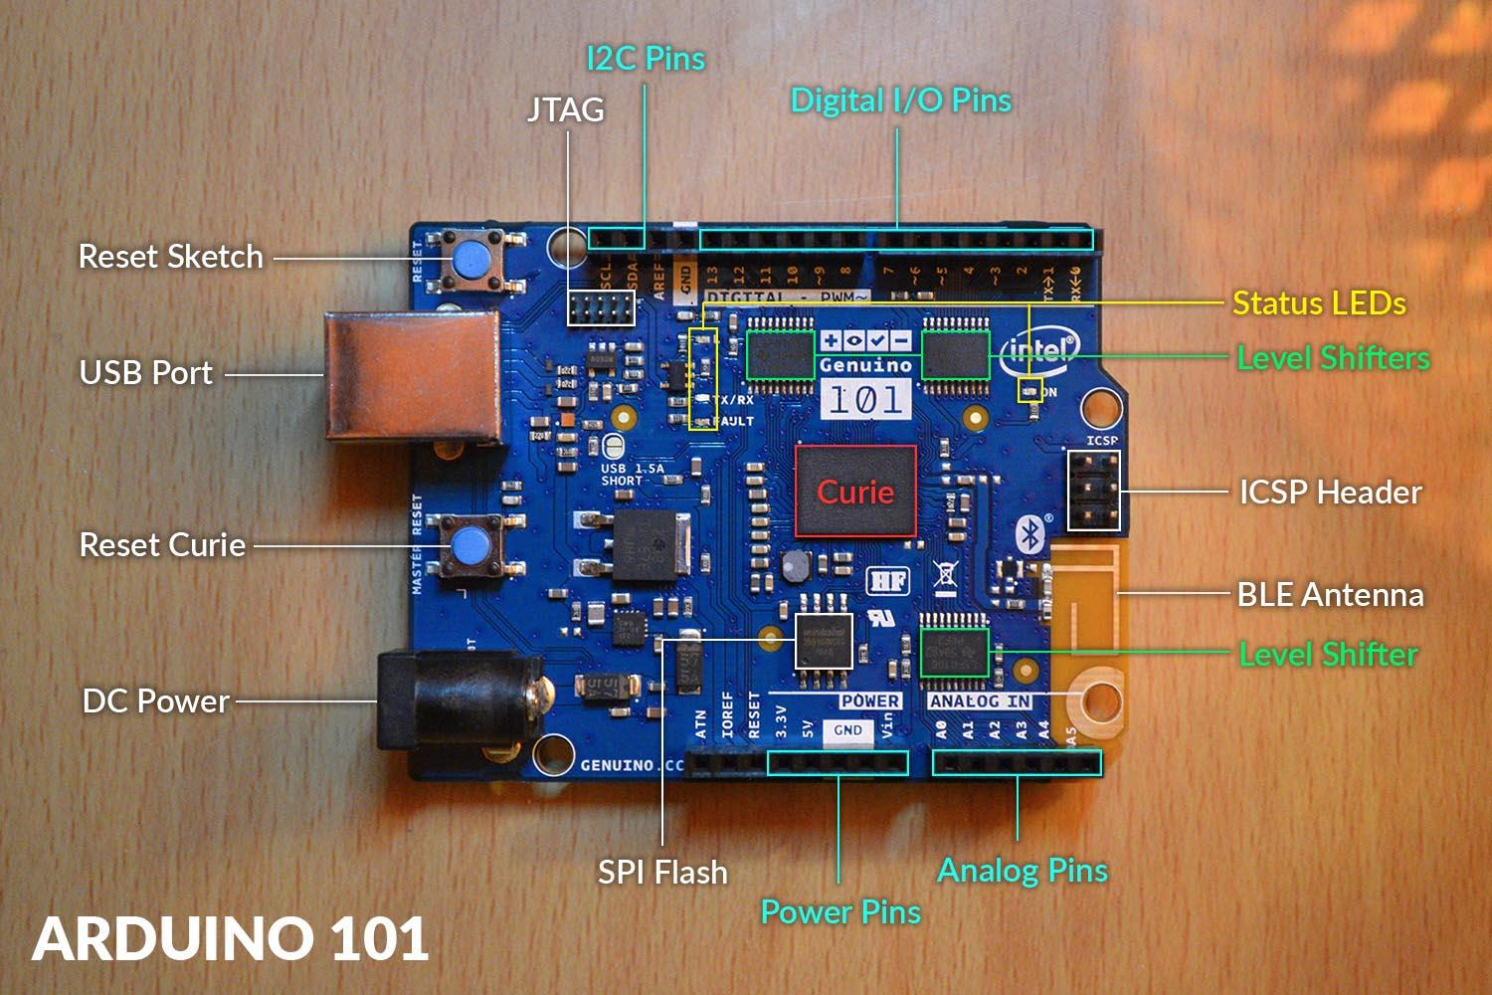
Arduino 101 - Genuino 101

Slide 6
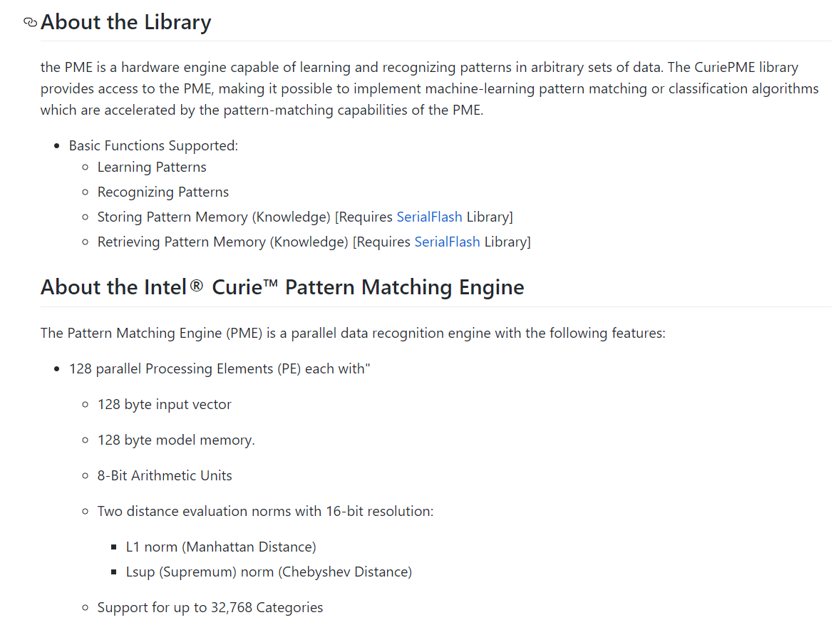
Intel Curie Libraries
CurieIMU
CurieBLE
CuriePME

Slide 7
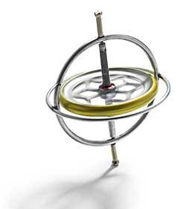
Intel Curie Gyroscope
Sensor capable of measuring angular velocity relative to 3 axes
User can vary using
Sensitivity parameter

Slide 8
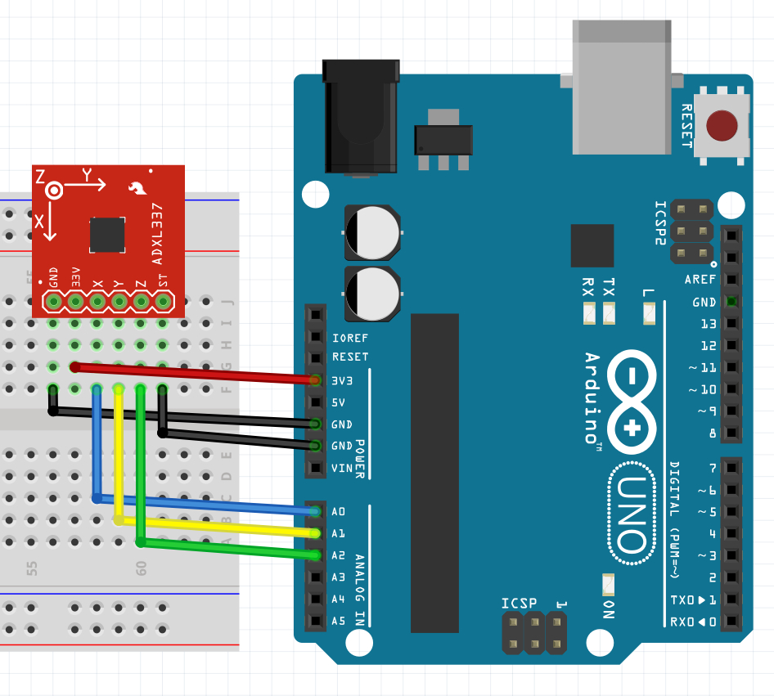
Intel Curie Accelerometer
Sensor capable of measuring acceleration relative to 3 axes
User can vary using
Range parameter

Slide 9

BLE vs Bluetooth
Target demographics
Sleep settings
Connection time
Frequency

Slide 10
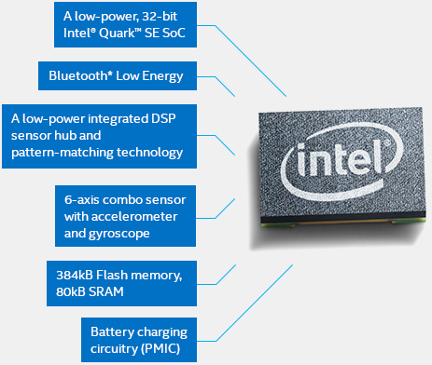
Pattern Matching Engine
128 Parallel Processing units
128 Byte memory, input vector
8 bit arithmetic unit

Slide 11
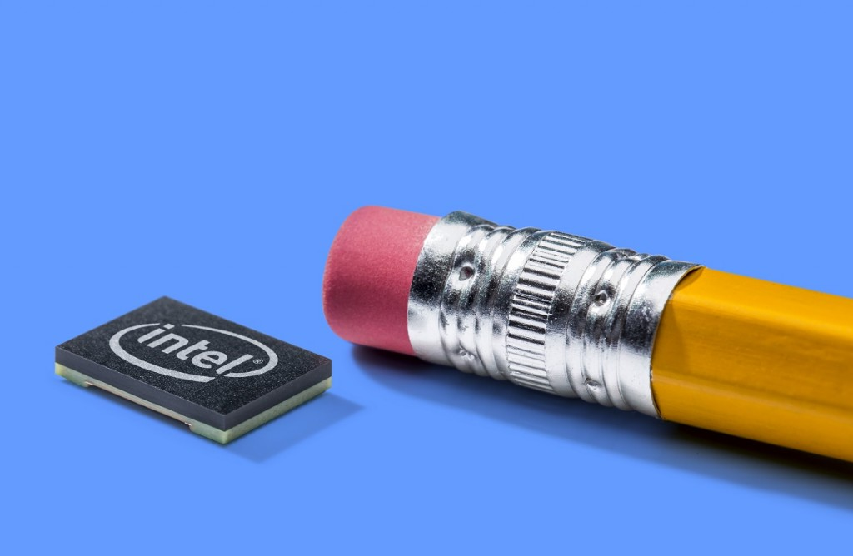
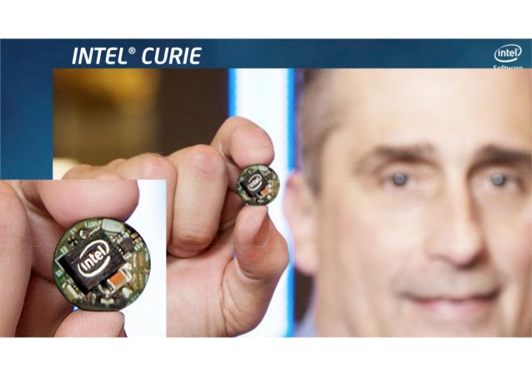
Why do we care?
Ease of using with arduino support
Easy and cheap prototyping; more libraries

Slide 12
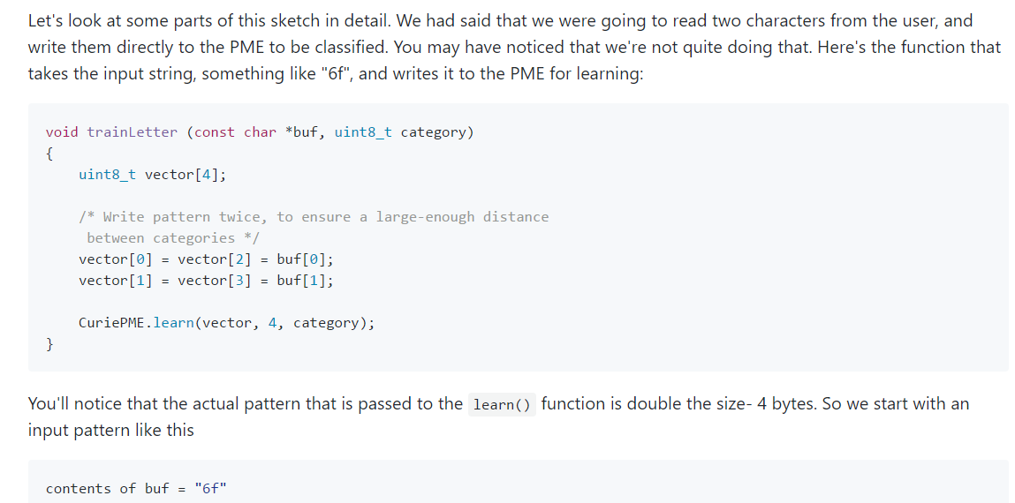
Intel Curie Pattern Matching Example Demo

Slide 13
Alternative Project using PME

Slide 14
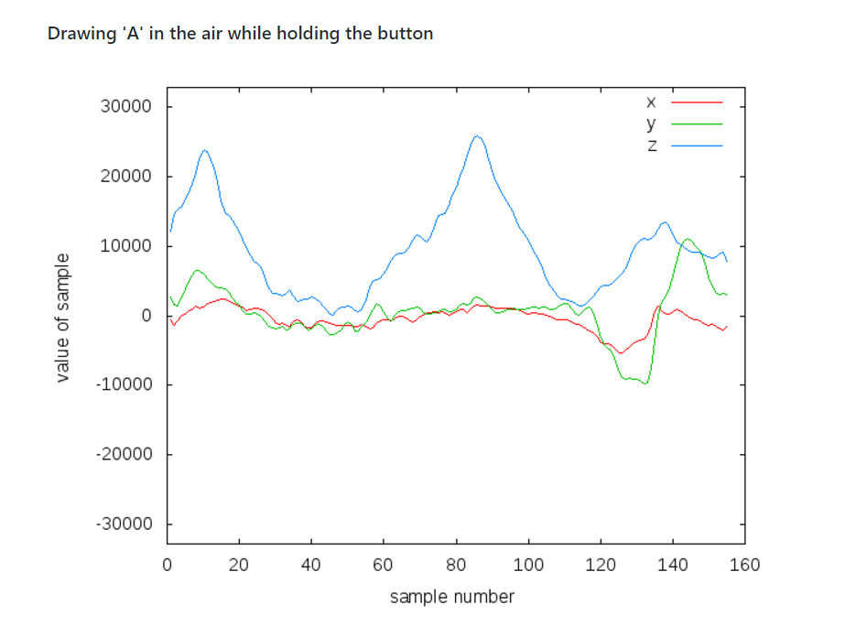
Sample Data from DrawingInAir

Slide 15
Thank You for your time.

